Slide 1
Welcome

Slide 2
Submitted To:
Dr. Mithun Kumar Das
Associate Professor
Department of Physics
Comilla University
Presented By:
Omma Habiba Nusrat (ID : 12409026)
Mst. Urmi Begum (ID : 12409027)
Md. Yasin Sarker (ID : 12409028)
Hasibul Islam (ID : 12409031)
Tonmoy Chowdhury (ID : 12409032)
MD. Razinur Rahman Razin (ID : 12409033)
Mahadi Hasan Fardin (ID : 12409034)
Humaira Mahbuba Khan Prova (ID : 12409036)

Slide 3
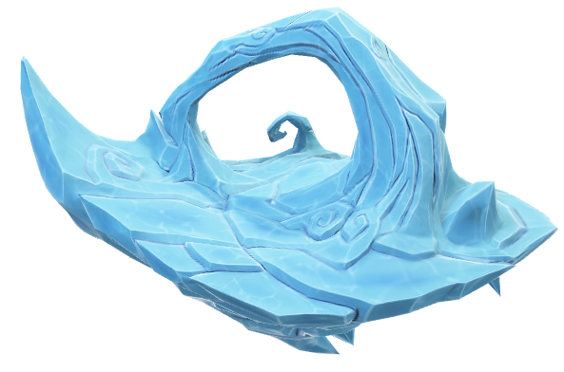
Chapter – 2
Vibrations and Waves

Slide 4
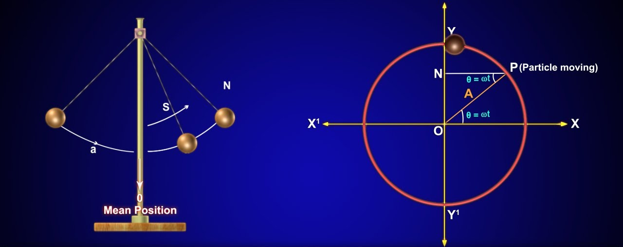
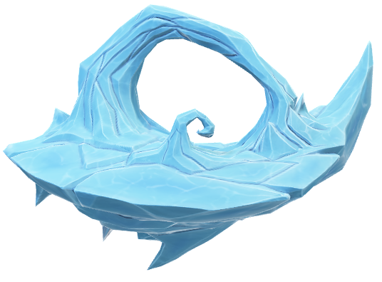
Simple Harmonic Motion (SHM)
Simple Harmonic Motion (SHM) is a type of back-and-forth movement, like a swing or a vibrating spring. It happens when an object moves around a central position in a regular and repeating way. The force pulling it back to the centre is always proportional to how far it is from the centre.

Slide 5
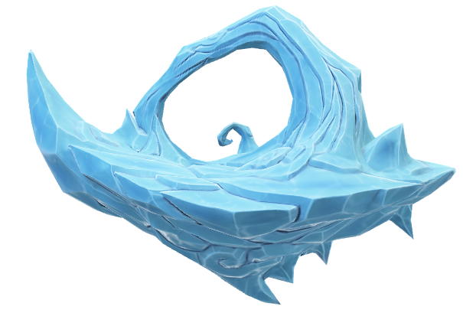
Conditions for SHM
The system should have restoring force.
The system should have inertia.
The system should be frictionless.

Slide 6
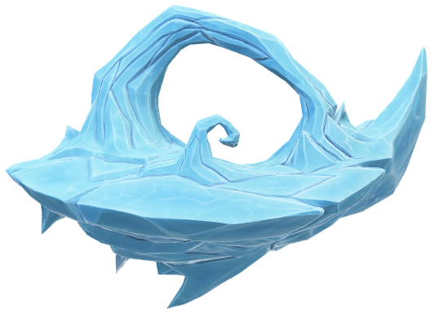
Free Vibrations
Free vibrations happen when an object is disturbed from its rest position and then allowed to move on its own without any external force acting on it. The object keeps vibrating due to its own energy.

Slide 7
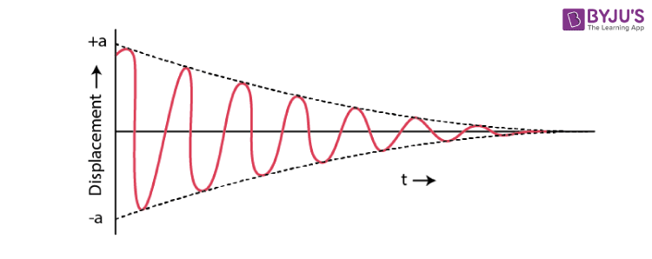
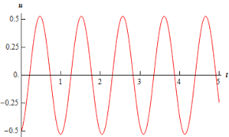
Free Vibrations
Damped Vibrations
Damped vibrations occur when an object vibrates but gradually loses energy due to friction, air resistance, or any other opposing force. Over time, the vibrations become smaller and eventually stop.
Undamped Vibrations
Undamped vibrations occur when an object keeps vibrating without losing energy because there is no friction or resistance to slow it down. The vibration continues forever with the same amplitude (size of motion).

Slide 8

Wave Motion
Wave motion is the transfer of energy from one place to another without the actual movement of matter. It happens through vibrations or oscillations.

Slide 9
Characteristics of Wave Motion
Wave motion is a disturbance caused by repeated periodic motion of particles in a medium.
The wave moves forward, but the particles only vibrate around their mean positions.
There is a regular phase change between particles ; the next particle starts vibrating slightly later.
Wave velocity is different from particle velocity. The wave moves uniformly, while particle velocity varies. It is maximum at the mean position and zero at extreme positions.

Slide 10
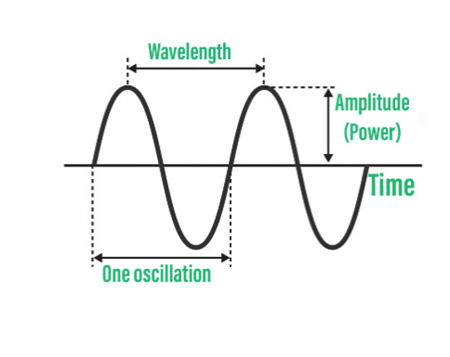
Definitions
Wavelength (λ) is the distance between two consecutive points in a wave that are in the same phase of motion.
Frequency (f) is the number of wave cycles (complete waves) that pass a fixed point in one second.
Amplitude is the maximum displacement of a wave from its mean (rest) position. It represents the height of the wave and determines the wave's energy.
Time Period (T) is the time taken for one complete wave cycle to pass a fixed point. It is measured in seconds (s).

Slide 11
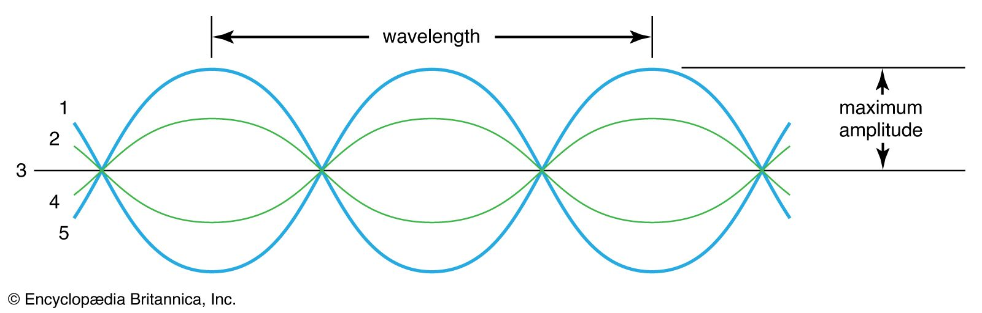
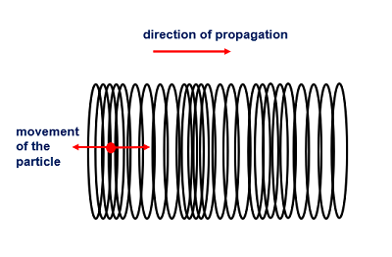
Types of Wave Motion
Transverse
Longitudinal

Slide 12
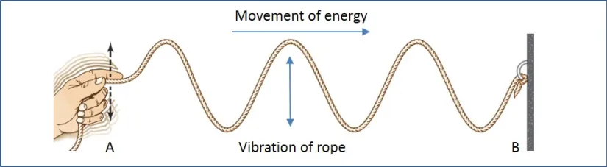
Transverse
In a transverse wave, particles move up and down while the wave moves forward.
Example: Water waves, light waves, and waves on a rope.

Slide 13
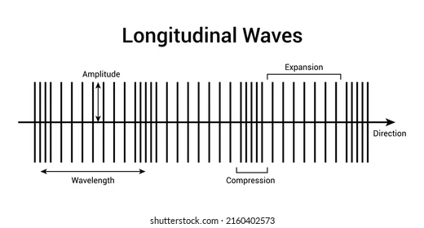
Longitudinal
In a longitudinal wave, particles move back and forth in the same direction as the wave.
Example: Sound waves, slinky waves, and P-waves in earthquakes.

Slide 15
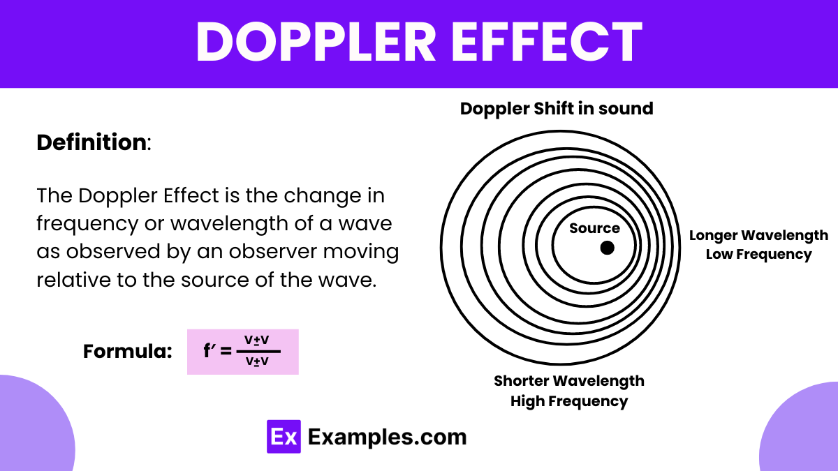

Slide 16
Thank you for watching

